Slide 1
CSE321: Operating Systems Lecture 0
Shakila Zaman(SZn)
Lecturer
Dept. of CSE, BRAC University
66 Mohakhali, Dhaka 1212, Bangladesh
( From : NARZU TARANNUM(NAT) )

Slide 2
Contact:
Room: UB50409
Email: shakila.zaman@bracu.ac.bd
For Consultation Time, Check “TSR”

Slide 3
Reference Book
▪ Silberschatz, Galvin, and Gagne, Operating System Principles, 7th ed., Wiley, 2006
▪ A. Tanenbaum, Operating Systems: Design and Implementation, 2nd ed., Prentice-Hall, 2001

Slide 4
Marks Distribution
Attendance – 5%
Quiz (3 to 4 [best 2]) –10%
Presentation/Assignment –5%
Mid Term Exam –20%
Final Exam –40%
Lab –20%

Slide 5
Course Outline
Operating Systems Overview and Introduction
Processes
Threads
CPU Scheduling
Process Synchronization
Deadlock
Memory Management
Virtual Memory

Slide 6
What is an Operating System?
A program that acts as an intermediary between a user of a computer and the computer hardware.
Operating system goals:
Execute user programs and make solving user problems easier.
Make the computer system convenient to use.
Use the computer hardware in an efficient manner.

Slide 7
To understand what OS are, we must first understand how they have developed.

Slide 8
History of OS
Single user single process
Batch Systems
Multi-Programmed Batched Systems
Time Sharing Systems
Personal-Computer Systems
Parallel Systems
Distributed Systems

Slide 9
Computer-system architecture
Single-processor systems :
Multiprocessor systems: (Parallel system or tightly coupled system) : two types
Asymmetric multiprocessing
symmetric multiprocessing(SMP)
Have three main advantages :-
Increased throughput
Economy of scale
Increased reliability

Slide 10
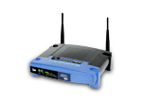
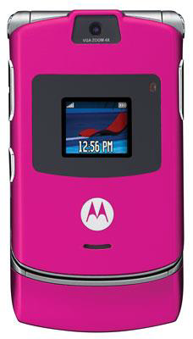
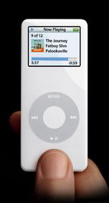
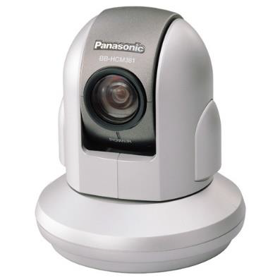
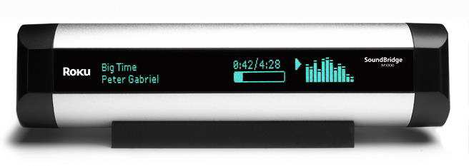
Computing Environment
Client-Server Systems
Mail server/service
File server/service
Compute-server system
Peer-to-Peer (P2P) Systems:
P2P computing or networking is a distributed application architecture that partitions tasks or work loads between peers. Peers are equally privileged, equipotent participants in the application.
Napster, Gnutella etc.
Web-based computing
Embedded and Mobile Systems

Slide 11
Primary functions of an os
Processes-process management
Storage-memory management
Data-file management
Input/output devices-i/o management

Slide 12
Secondary functions of an os
User Accounting
Logging
Utility software-calculator, calendar, find, clock, help etc.

Slide 13
THANK YOU

